Slide 1
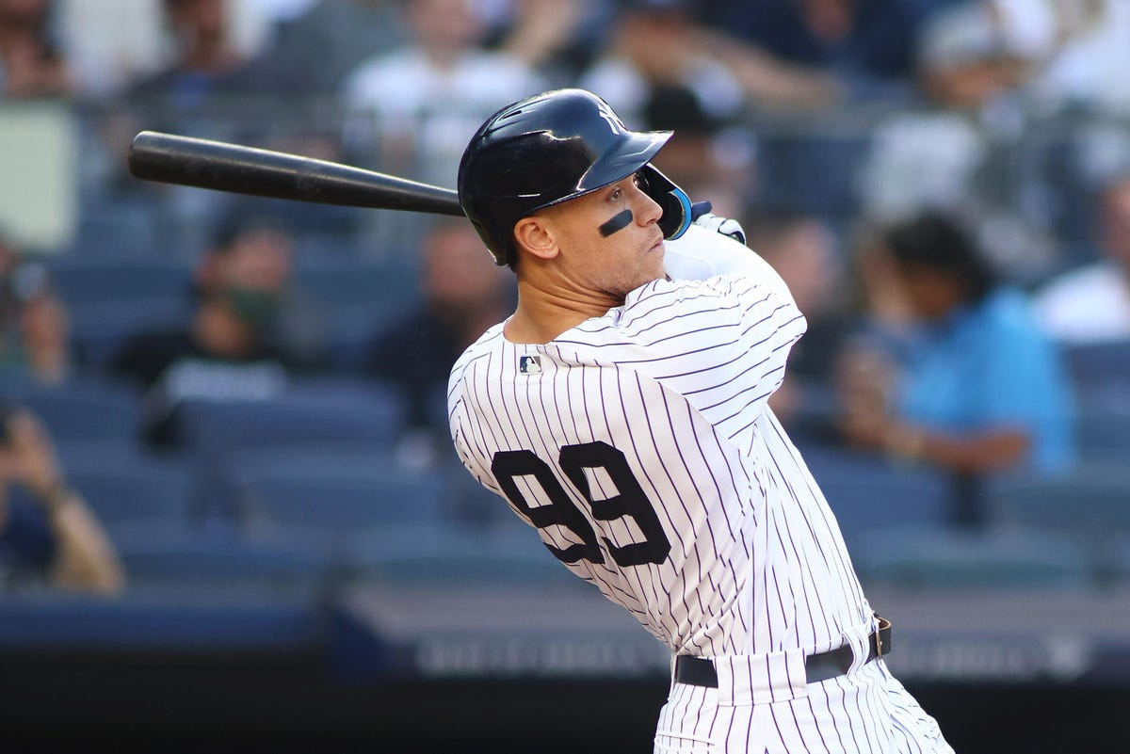

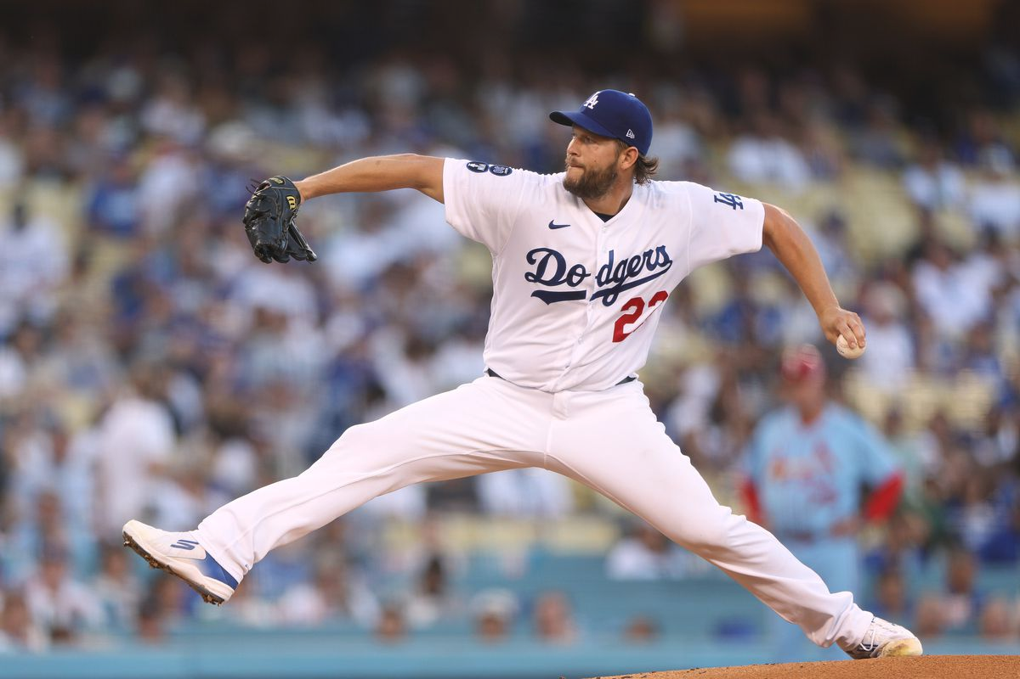
Fantasy Baseball Projections
Suhas Buravalla and Carter Rogers
DATS6501 - Data Science Capstone
.311 AVG, 62 HR, 131 RBI, 133 R, 16 SB
21 W, 1.77 ERA, 239 SO, 0.86 WHIP

Slide 2

Agenda
Background
Problem Statement
Prior Research
Our Data Set: Gathering, Preprocessing, Features & Targets
Modeling: Approach & Methodology
Results
Conclusion
Fantasy Baseball Projections - DATS6501

Slide 3

Background
Major League Baseball vs. Fantasy Baseball
“Moneyball”, advanced analytics
Statcast creating new wave of data in MLB
Using data to gain competitive edge, drive decision-making
How to measure and predict player performance?
Fantasy Baseball Projections - DATS6501

Slide 4

Background
Fantasy Baseball
Rotisserie 5x5 Standard Format
Real life player results dictate success of fantasy team
Using basic stats to measure performance
How to predict player performance?
Projection systems – ZiPS, Steamer, The BAT X
Limitations
Fantasy Baseball Projections - DATS6501

Slide 5

Problem Statement
Rotisserie 5x5 Scoring:
Hitters – Batting Average, Home Runs, Runs Batted In, Runs Scored, Stolen Bases
Pitchers – Wins, Earned Run Average, Strikeouts, Saves, Walks + Hits per Inning Pitched
Problem Statement: Develop a predictive model using real-world baseball data to project future fantasy baseball results
Fantasy Baseball Projections - DATS6501

Slide 6
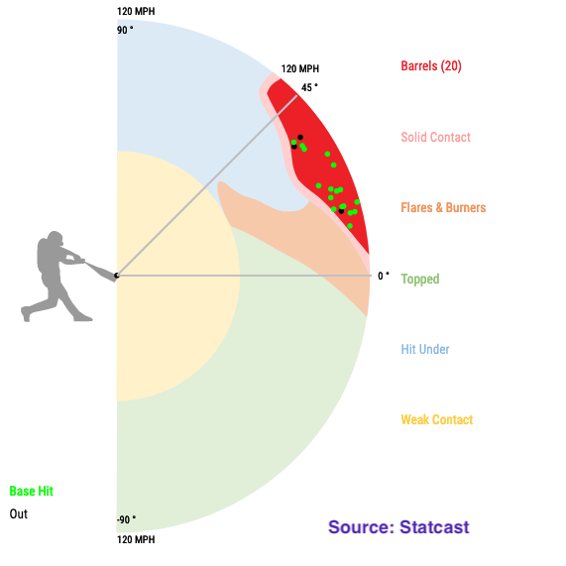
Prior Research
Eno Sarris (The Athletic) – Barrel% more predictive of future power than any other stat
Alex Fast (PitcherList) – CSW% (Called Strikes + Whiffs) stabilizes in smaller samples, highly correlated with strikeouts
Ben Clemens (Fangraphs) – Exit Velocity and Contact Rate stickiest metrics from year-to-year
Fantasy Baseball Projections - DATS6501

Slide 7


Our Data Set – Gathering
Fangraphs – historical repository for basic and advanced metrics for hitters & pitchers
2008-2022: pitch tracking era, access to metrics calculated per pitch (Swing%, CSW%)
2015-2022: Statcast metrics (Exit Velocity, Launch Angle, Sprint Speed)
Pull individual yearly statistics from 2008-2022 for hitters and pitchers
Fantasy Baseball Projections - DATS6501

Slide 8
Our Data Set – Preprocessing & Features
For each player: merge prior year’s data with following year
Impute missing Statcast metrics from 2008-2014 when unavailable
Features of both Hitters and Pitchers Data Sets – basic stats (prior year’s fantasy stats), advanced metrics, batted ball quality, swing decisions, Team, and Age
53 Features for Hitters Data Set, 59 for Pitchers
Fantasy Baseball Projections - DATS6501

Slide 9
Our Data Set – Targets
Hitters (2008-2022) – 14.3k Rows
Pitchers (2008-2022) – 7.4k Rows
X (Features) – 53 Columns
X (Features) – 59 Columns
Y₁ – Home Runs (HR)
Y₂ – Runs (R)
Y₁ – Wins (W)
Y₂ – Saves (SV)
Y₃ – Runs Batted In (RBI)
Y₄ – Stolen Bases (SB)
Y₃ – Earned Run Average (ERA)
Y₄ – Strikeouts (SO)
Y₅ – Batting Average (AVG)
Y₅ – Walks + Hits per Inning Pitched (WHIP)
Fantasy Baseball Projections - DATS6501

Slide 10

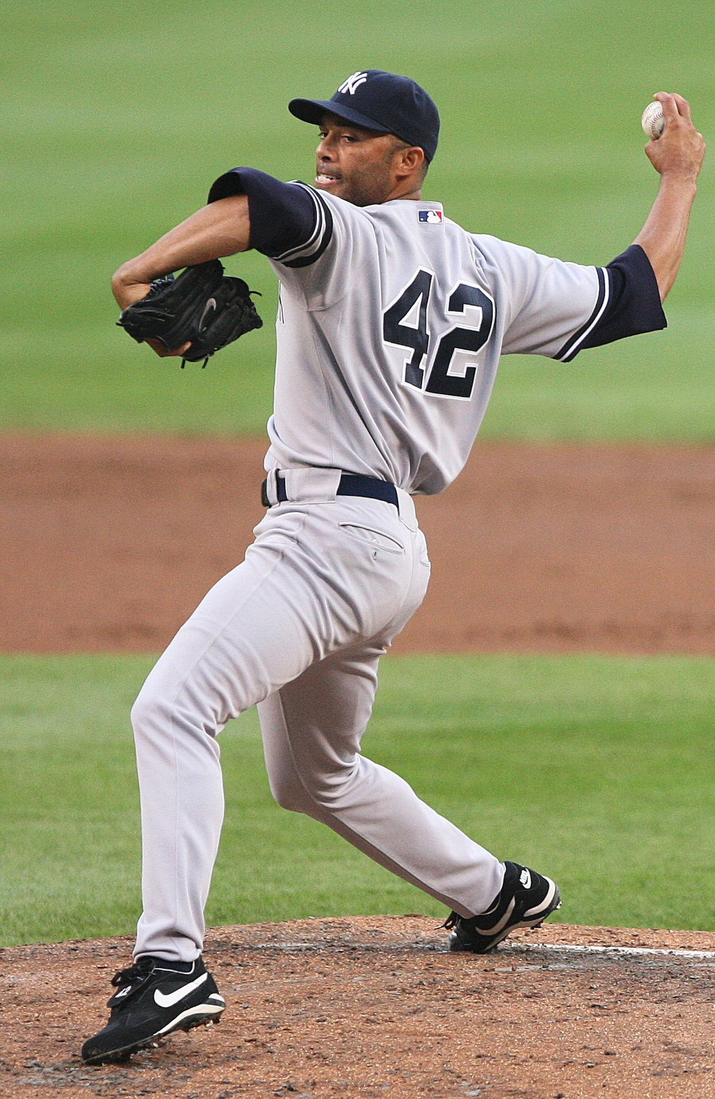
Modeling – Approach
Hardest targets to predict: SB (Hitters) and Saves (Pitchers) – why?
Wide data set – pros and cons
Prefer models with:
Support for multi-target regression output
Inherent feature selection
Better performance on data sets with fewer observations
2 models with 5 outputs each vs. 10 separate models
Fantasy Baseball Projections - DATS6501

Slide 11
Modeling – Methodology
Target* | Naïve Model MSE
HR | 0.516
R | 0.419
RBI | 0.434
SB | 0.521
AVG | 0.832
Naïve Model – Use prior year’s fantasy stats to predict targets
Limitations of naïve model – why can’t we use this approach?
What our modeling approach cannot account for?
Injuries – how to quantify and predict?
Trades, acquisitions, and free agent signings
Other factors – changes in pitch mix, swing alterations, offseason training, etc.
Target* | Naïve Model MSE
W | 0.841
SV | 0.717
ERA | 1.816
SO | 0.695
WHIP | 1.762
*normalized
Fantasy Baseball Projections - DATS6501

Slide 12
Modeling – Methodology
Fantasy Baseball Projections - DATS6501

Slide 13
Modeling – Methodology
Fantasy Baseball Projections - DATS6501

Slide 14
Results
Fantasy Baseball Projections - DATS6501

Slide 15
Conclusion
Fantasy Baseball Projections - DATS6501

Slide 16
Works Cited
Sarris, Eno. “Sarris: 10 Bold Predictions for the 2023 MLB Season.” The Athletic, 24 Mar. 2023, https://theathletic.com/4312841/2023/03/24/sarris-ten-bold-predictions-mlb-2023/.
Fast, Alex. “CSW Rate: Intro to a New Fantasy Baseball Metric.” Pitcher List, 5 Dec. 2022, https://www.pitcherlist.com/csw-rate-an-intro-to-an-important-new-metric/.
Clemens, Ben. “You Can't Fake Exit Velocity.” FanGraphs Baseball, 6 Feb. 2023, https://blogs.fangraphs.com/you-cant-fake-exit-velocity/.
Fantasy Baseball Projections - DATS6501

